Slide 1
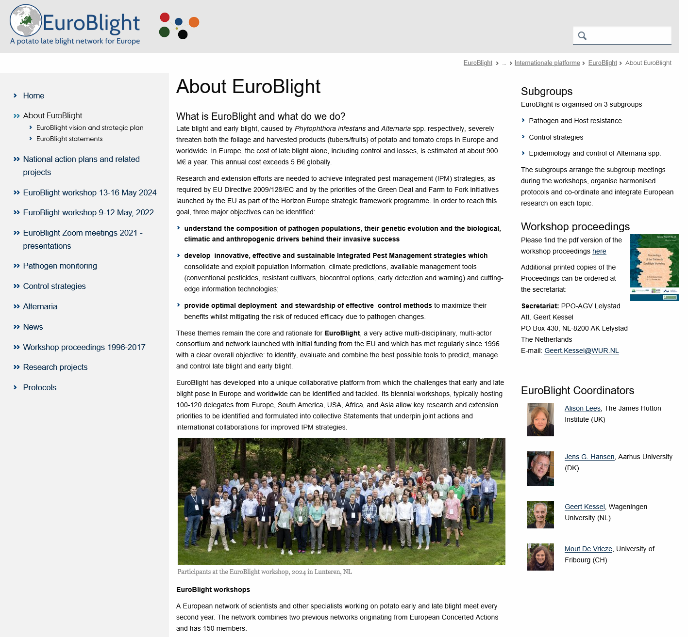

Slide 2
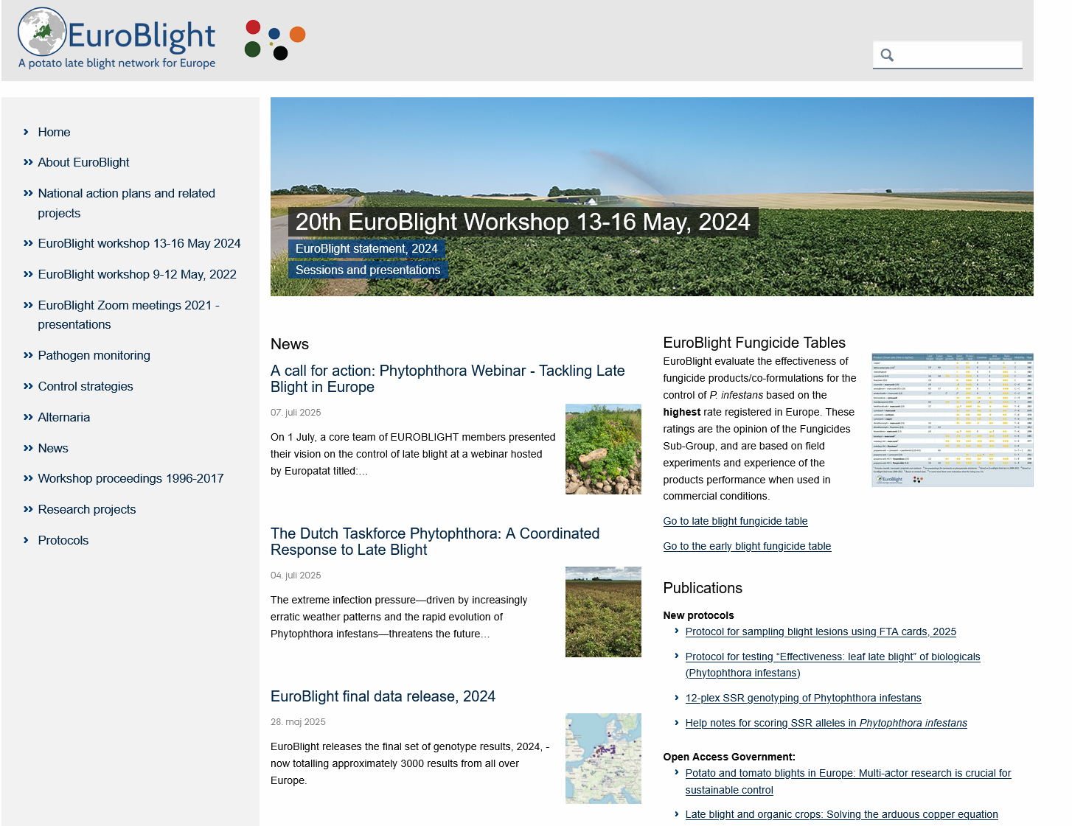
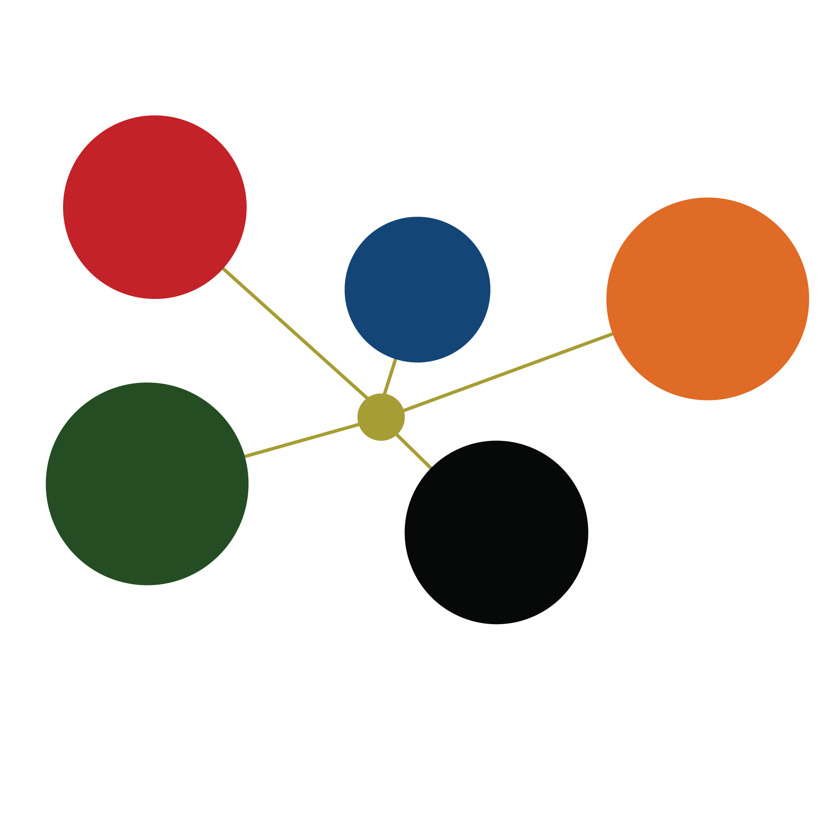
EuroBlight –
A potato late blight network for Europe
Global infrastructure,
A network of networks:
N. America
Europe
Asia
S. America
Africa

Slide 3
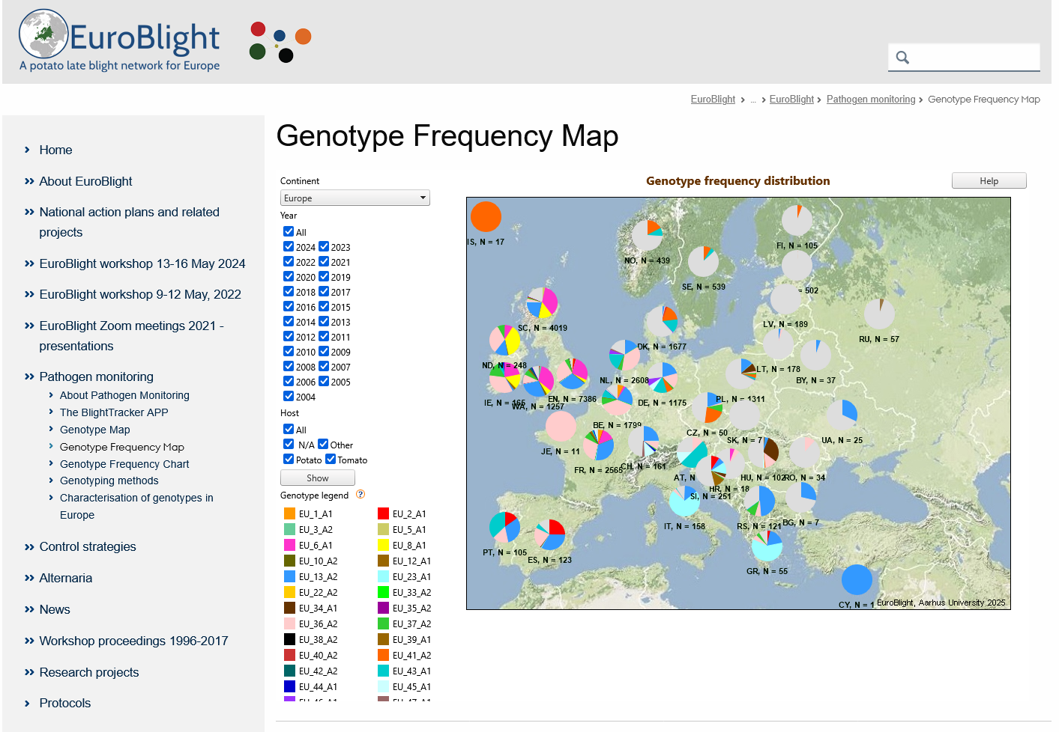
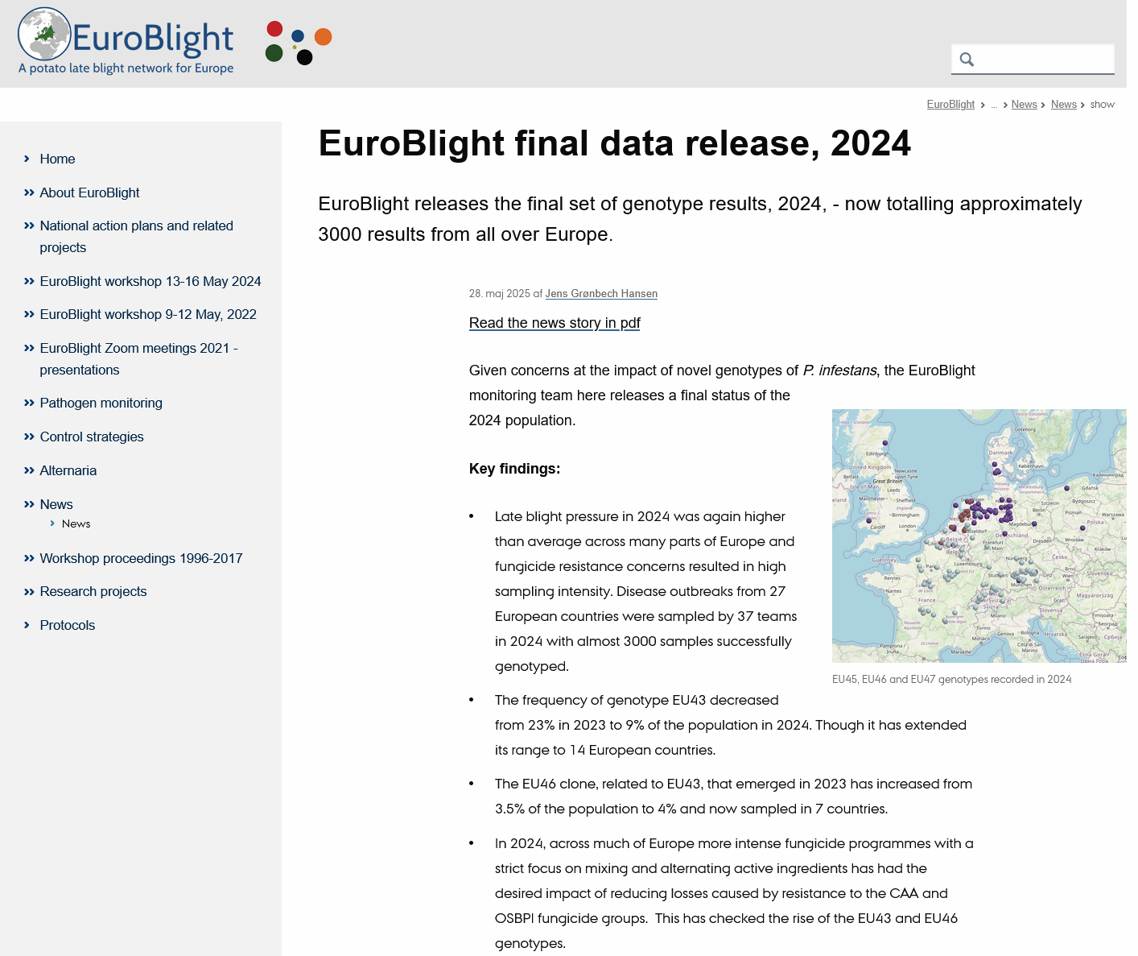
Pathogen monitoring

Slide 4
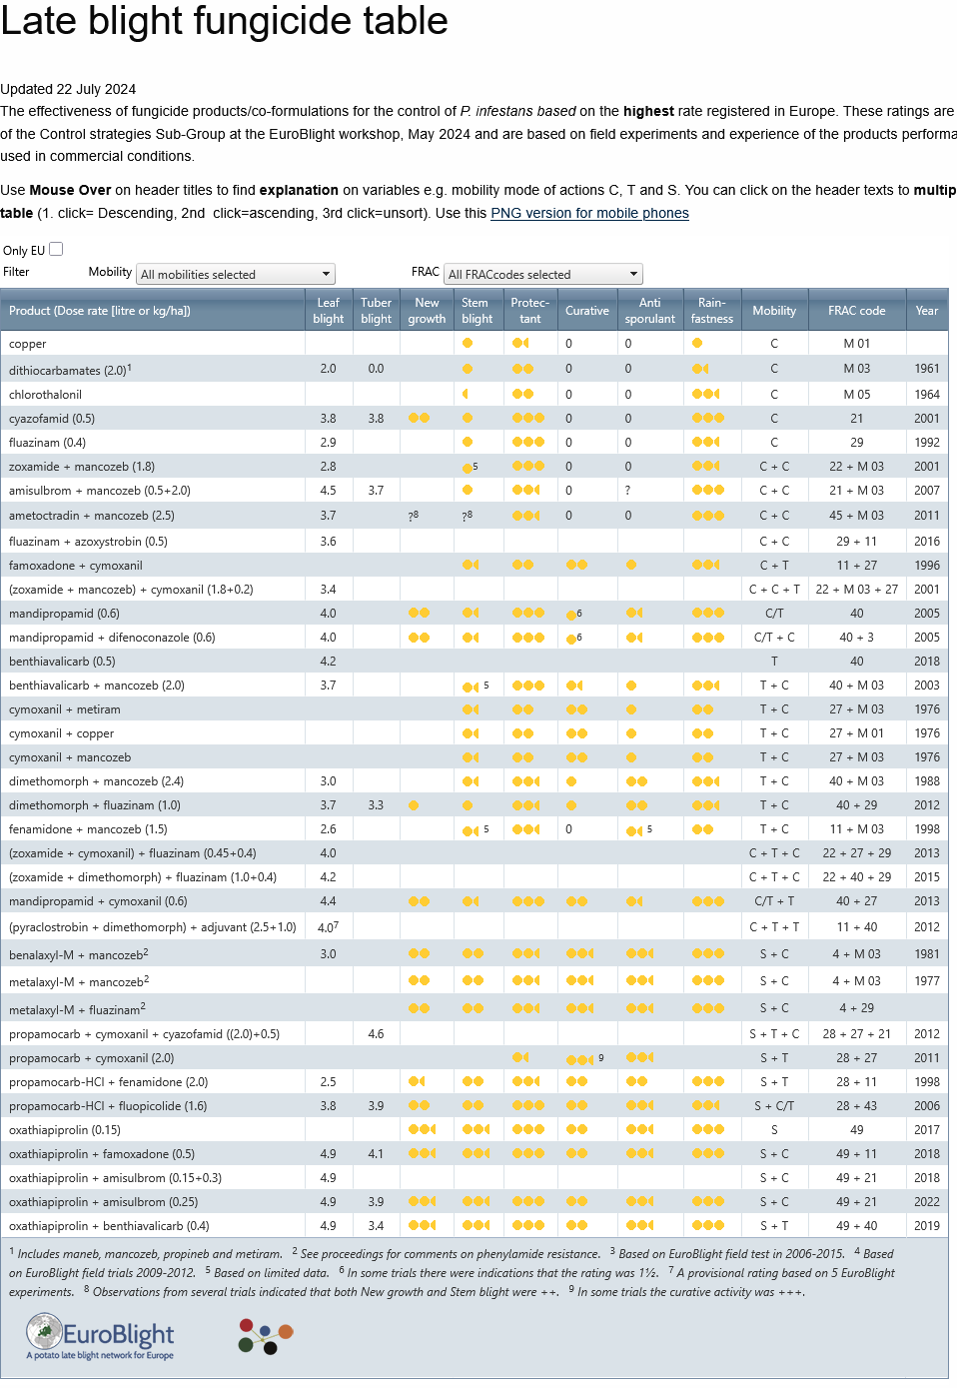
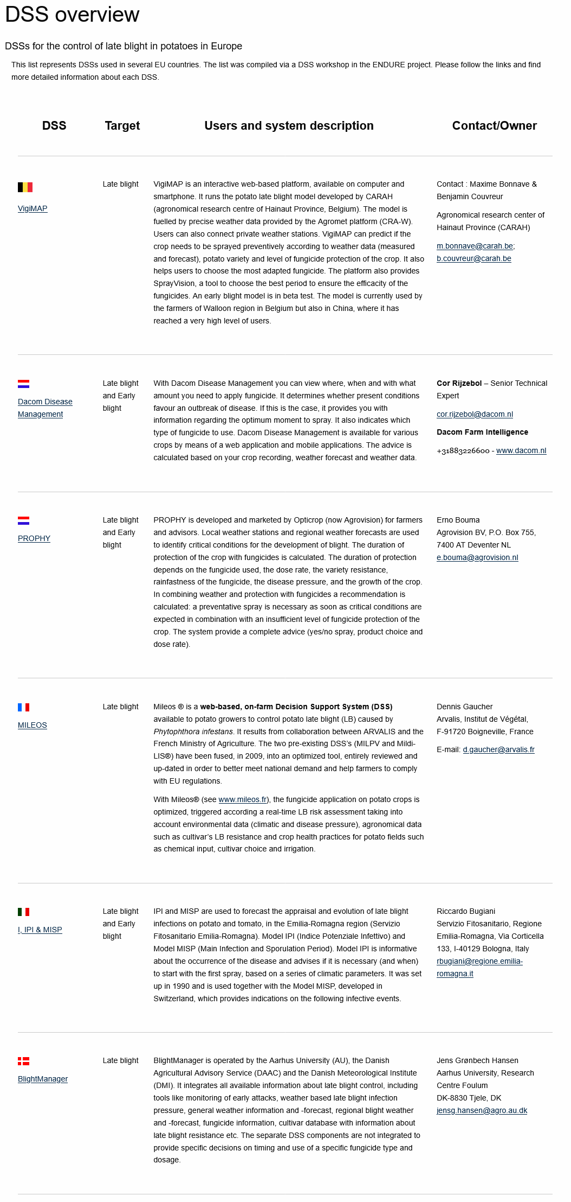
Late Blight fungicide table
and
DSS information

Slide 5
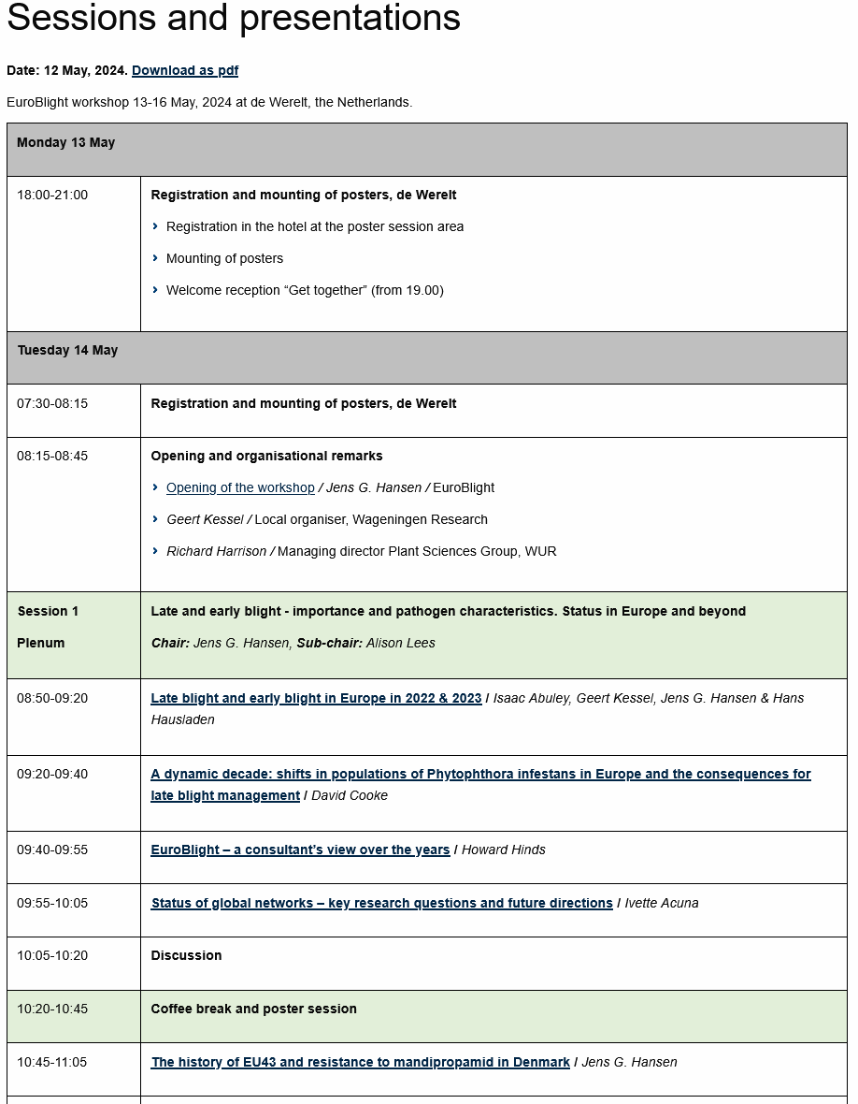
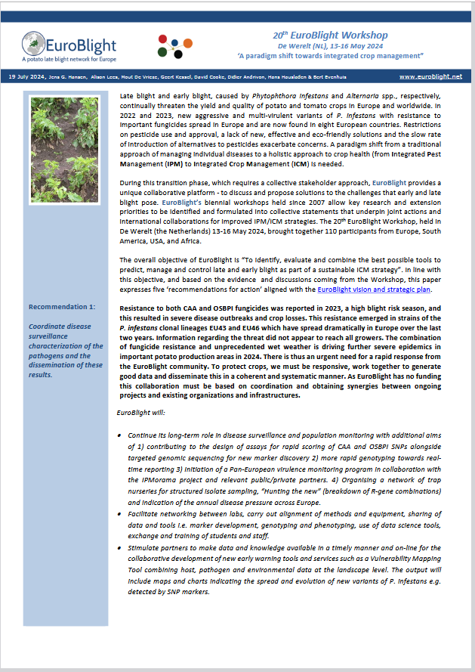
Bi-annual workshops
Release of a
EuroBlight statement
With recommendations

Slide 6
EuroBlight, Potato late blight early warning – initiatives and activities in 2024 and beyond.
Jens G. Hansen, Alison Lees, Geert Kessel & Mout deVries EuroBlight Mgmt
We need action!
Super goal: Sustainable potato production – economic and environmental
Collaboration and Infrastructures to mitigate devastating potato late blight epidemics
From IPM to ICM - EuroBlight vision and strategic plan. How to implement this paradigm shift in practice?
EuroBlight - potato late blight early warning – Actions needed? - How can we do more together?
infrastructures to mitigate devastating potato late blight epidemics – National, EuroBlight, Global, Policy – collaboration?
Introduction of IPMorama (Kick-off 2-4 October 2024) – Late blight is a use case on ”Breeding for IPM”

